Slide 1
On the Road to Reliability for Android Robots in a Physical World
SOFTWARE QUALITY CONFERENCE
PACIFIC NW
KRISHNA SAXENA, TORIN PERKINS, CATHERINE LEE, JAMES MENEZES AND BO LI [OCTOBER 8-10, 2018]
PNSQC ™

Slide 2
Key Points and Overview of Content
SOFTWARE QUALITY CONFERENCE
PACIFIC NW
Introduction
For Inspiration and Recognition of Science and Technology (FIRST) and FIRST Tech Challenge (FTC) Android robots
Challenges for software reliability
Fault tree analysis (FTA), software failure mode and effects analysis (SFMEA) and software reliability shortcut model
Case Study
Android robot autonomous glyph collections and delivery
Image detection through Android phone camera
Conclusions
PNSQC ™

Slide 3
Introduction
SOFTWARE QUALITY CONFERENCE
PACIFIC NW
Robotics software reliability is crucial to control robot hardware while interacting with the physical world
Software reliability modeling and methodology are employed on the road to software reliability.
Shared the experiences how FIRST Tech Challenge (FTC) robotics team improves software reliability along with detail case studies.
PNSQC ™

Slide 4
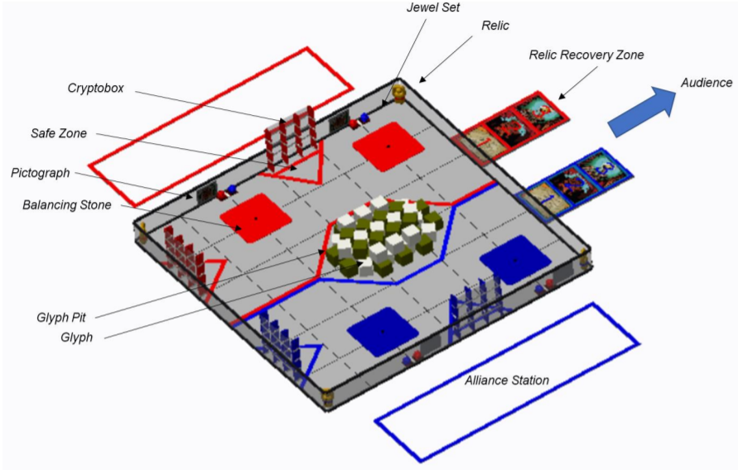
Introduction to FIRST Tech Challenge (FTC)
SOFTWARE QUALITY CONFERENCE
PACIFIC NW
FTC competition field: 12’ by 12’. Each alliance has 2 robots.
PNSQC ™

Slide 5
Introduction to FIRST Tech Challenge (FTC): Control Robot
SOFTWARE QUALITY CONFERENCE
PACIFIC NW
Android phone controls robots
PNSQC ™

Slide 6
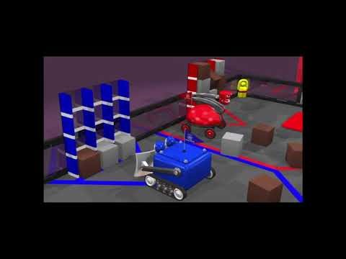
FIRST Tech Challenge Game Video
SOFTWARE QUALITY CONFERENCE
PACIFIC NW
PNSQC ™

Slide 7
Challenges for Software Reliability in a Physical World
SOFTWARE QUALITY CONFERENCE
PACIFIC NW
Software reliability is the probability of failure free operation of a computer program in a specified environment for a specified period of time
Software reliability challenges:
Effective software defect removal and rapid adaptability to new capabilities
Utilize software algorithms to minimize sensor variability while processing physical world inputs
PNSQC ™

Slide 8
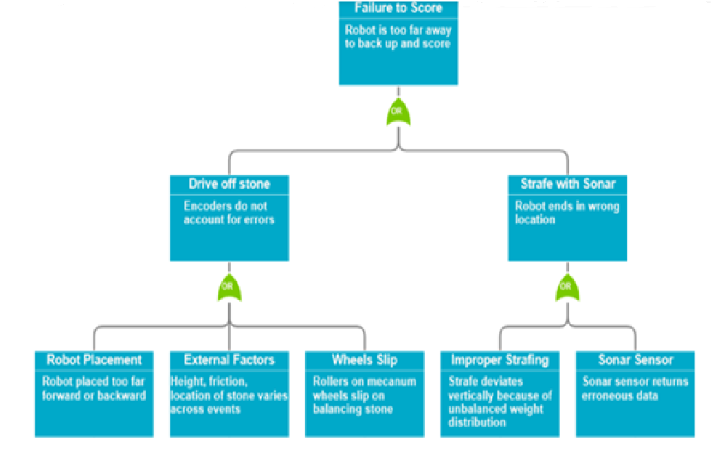
Software Reliability Method: Fault Tree Analysis (FTA)
SOFTWARE QUALITY CONFERENCE
PACIFIC NW
PNSQC ™

Slide 9
Case Study #1: Fault Tree Analysis (FTA) and Testing
SOFTWARE QUALITY CONFERENCE
PACIFIC NW
FTA directed the testing strategy and coverage:
Balancing Stone Selection (4 Balance Stones) | Cryptobox Destination (either near alliance station or far away) | Jewel Flick
Red stone 1 (Left, Face Alliance Station) | Column 1 @ far Crytobox Column 2 @ far Crytobox Column 3 @ far Crytobox | Jewel on Left Jewel on Right
Red stone 1 (Right, Face Alliance Station) | Column 1 @ near Crytobox Column 2 @ near Crytobox Column 3 @ near Crytobox
Blue stone 1 (Left, Face Alliance Station) | Column 1 @ far Crytobox Column 2 @ far Crytobox Column 3 @ far Crytobox
Blue stone 2 (Right, Face Alliance Station) | Column 1 @ near Crytobox Column 2 @ near Crytobox Column 3 @ near Crytobox
PNSQC ™

Slide 10
Software Reliability Method: Software FMEA (Failure Modes and Effects Analysis)
SOFTWARE QUALITY CONFERENCE
PACIFIC NW
Both hardware and software errors need to be addressed in SFMEA.
Fault Category | Definitions | Key Fault Events Being Addressed | Fault Category
Functionality: Fault sequence/ order | A particular event is initiated in the incorrect order or not at all. | Fault Event: The robot lifting level in the software was set to zero at the incorrect lifting position due to the autonomous program stopped by the glyph Solution: Developed the software reset program and trigger the one button manual reset at the beginning of the tele operation (TeleOpe) session to recover in 1 sec. | Functionality: Fault sequence/ order
Functionality: Fault data | Data is corrupted, incorrect, etc. | Fault Event: The robot back sonar sensor reading incorrect data caused the wrong traveling distance. Solution: added the error protection in the software program to cap within the threshold for the traveling distance to avoid hitting the balance stone. | Functionality: Fault data
PNSQC ™

Slide 11
Software Reliability Shortcut Model Survey: Strengths
SOFTWARE QUALITY CONFERENCE
PACIFIC NW
 |  | 9.5 points
1 | We protect older code that shouldn't be modified. | Yes (1)
2 | The total schedule time in years is less than one. | Yes (1)
3 | The number of software people years for this release is less than seven. | Yes (1)
4 | Domain knowledge required to develop this software application can be acquired via public domain in short period of time. | Yes (1)
5 | This software application has imminent legal risks. | No (0)
6 | Operators have been or will be trained on the software. | Yes (1)
7 | The software team members who are working on the same software system are geographically collocated. | Yes (1)
8 | Turnover rate of software engineers on this project is < 20% during course of project. | Yes (1)
9 | This will be a maintenance release (no major feature addition). | No (0)
10 | The software has been recently reconstructed (i.e., to update legacy design or code). | No (0)
11 | We have a small organization (<8 people) or there are team sizes that do not exceed 8 people per team. | Yes (1)
12 | We have a culture in which all software engineers’ value testing their own code (as opposed to waiting for someone else to test it). | Somewhat (0.5)
13 | We manage subcontractors—Outsource code that is not in our expertise, keep code that is our expertise in house. | No (0)
14 | There have been at least four fielded releases prior to this one. | No (0)
15 | The difference between the most and least educated end user is not more than one degree type (i.e., bachelors/masters, high school/associates). | Yes(1)
PNSQC ™

Slide 12
Software Reliability Shortcut Model Survey: Risks
SOFTWARE QUALITY CONFERENCE
PACIFIC NW
 |  | 3.25 point
1 | This is brand new release (version 1), or development language, or OS, or technology (add one for each risk). | Yes (1)
2 | Target hardware/system is accessible within 0.75 points for minutes, 0.5 points for hours, 0.25 points for days, and 0 points for weeks or months. | 0.75
3 | Short term contractors (< 1 year) are used for developing line of business code | No (0)
4 | Code is not reused when it should be | Somewhat (0.5)
5 | We wait until all code is completed before starting the next level of testing | No (0)
6 | Target hardware is brand new or evolving (will not be finished until software is finished) | Yes (1)
7 | Age of oldest part of code >10 years | No (0)
PNSQC ™

Slide 13
Shortcut Model: Defect Density Prediction
SOFTWARE QUALITY CONFERENCE
PACIFIC NW
Subtracting the result of “Risk” points from the result of “Strength” points:
The resulting defect density prediction is then multiplied by the normalized effective KSLOC (EKSLOC) to determine the defect density. EKSLOC is a weighted average of new, modified, reused, and auto-generated code.
EKSLOC = New KSLOC + (A × major modified KSLOC) + (B × moderate modified KSLOC) + (C × Minor modified KSLOC) + (D × reused KSLOC without modification) + (E × auto-generated KSLOC)
* KSLOC: Kilo Source Line of Code
Value | Predicted Defect Density
≥ 4.0 | 0.11
≤ 0.5 | 0.647
>0.5 AND <4.0 | 0.239
PNSQC ™

Slide 14
Shortcut Model : Predicted # of Defects
SOFTWARE QUALITY CONFERENCE
PACIFIC NW
Typical effectiveness multipliers for different source codes:
Normalized EKSLOC is then normalized for languages:
Software predicted # of defects:
= EKLSOC * Language Normalization Conversion * Predicted Defect Density
Multiplier | Ranges | Function of
A—major modification | ≥ 40% | Magnitude of requirements change.
B—moderate modification | 20% to 40% | Magnitude of design change and cohesiveness of design.
C—minor modification | 5% to 20% | Cohesiveness of code (ability to change it w/o breaking an unrelated function).
D—reused | 0% to 30% | Cohesiveness of design. How long the reused code has been in operation.
E—auto generated | 0% to 10% | The ability to program the automated tool to provide code as per the design and requirements.
Language type | Normalization conversion
High order language such as C, Fortran, etc. | 3.0
Object oriented language such as Java, C++, C# | 6.0
Hybrid | 4.5
PNSQC ™

Slide 15
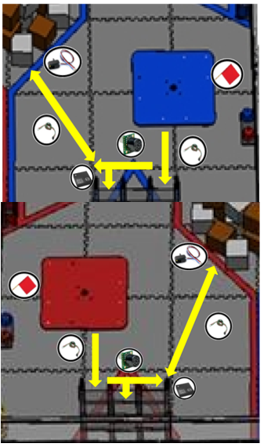
Case Study #1: FTC Robot Autonomous Glyphs Collections
SOFTWARE QUALITY CONFERENCE
PACIFIC NW
Target is to pick up 2 to 3 glyphs in autonomous and deliver to cryptobox
Software reliability stable when only delivering 1 glyph
Prior to the Houston Championship ~50% of code changed to deliver 2 to 3 glyphs and increase the chance of robot scoring higher
PNSQC ™

Slide 16
Case Study #1: Shortcut Model Defect Predictions
SOFTWARE QUALITY CONFERENCE
PACIFIC NW
Robot software reliability model Effective Kilo Source Line of Code (EKSLOC)
LRU | New KSLOC | Major modified KSLOC | Moderate modified KSLOC | Minor modified KSLOC | Reused KSLOC | Auto generated code in KSLOC | Total EKSLOC
Weight | 100% | 40% | 30% | 15% | 5% | 1%
Software prior to April, 2018 | 5 | 0 | 0 | 0 | 0 | 0 | 5
Software post April, 2018 | 2.5 | 0 | 0 | 0 | 2.5 | 0 | 2.5 + 0.125 = 2.625
Robot software predicted # of defects
Total EKSLOC | Language KLSOC | Normalization for this language | Normalized EKLSOC | Predicted defect density | Predicted defects = predicted defect density × normalized EKSLOC
Software prior to April, 2018 | 5 | 6 | 5 | 0.11 | 5 X 6 X 0.11 = 3.3
Software post April, 2018 | 5 | 6 | 2.625 | 0.11 | 2.625 X 6 X 0.11 = 1.73
PNSQC ™

Slide 17
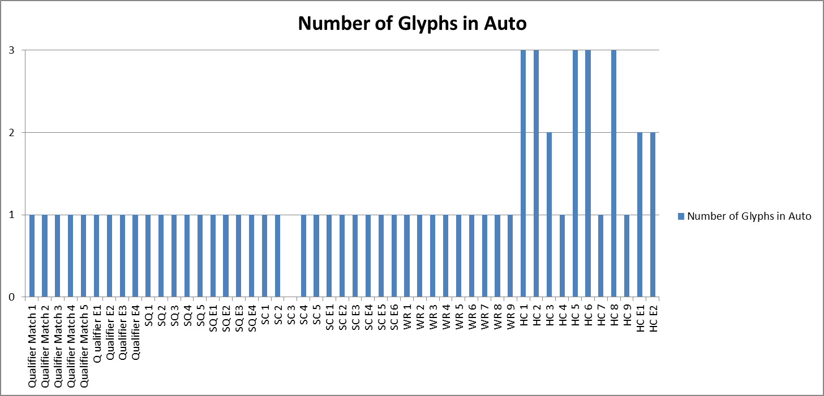
Case Study #1: The Android Robot Defects in Real Matches
SOFTWARE QUALITY CONFERENCE
PACIFIC NW
The # of defect matches the shortcut model predictions.
The MTBF (Mean Time between Failure) is 720 seconds when considering both failures for SC#3 and HC #9.
PNSQC ™

Slide 18
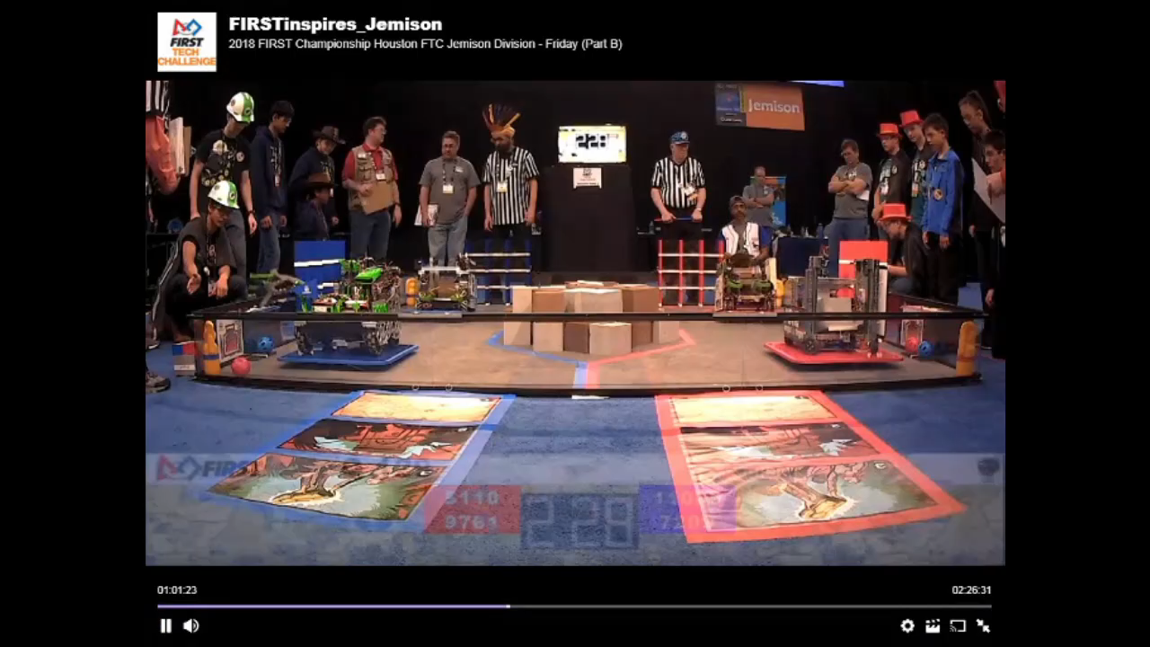
Video of Defect in HC #9 Match
SOFTWARE QUALITY CONFERENCE
PACIFIC NW
PNSQC ™

Slide 19
Case Study #1: Software Reliability Model Benefits
SOFTWARE QUALITY CONFERENCE
PACIFIC NW
How software reliability model helped the team?
Robot defect removal and reliability improvement (e.g., FTA, SFMEA)
Houston World Competition code redesign decision and implementations strategy (e.g., code reuse, physical input considerations, etc.)
PNSQC ™

Slide 20
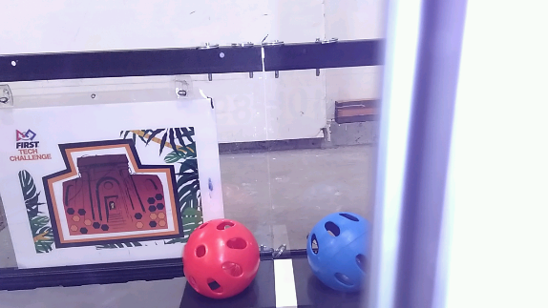
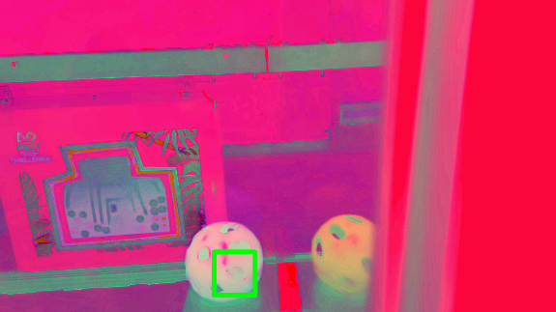
Case Study #2: Jewel Detection Algorithms
SOFTWARE QUALITY CONFERENCE
PACIFIC NW
Self-correction Image Detection through Android Phone Camera Image
The jewel detection utilizes Vuforia and OpenCV to locate the center of the VuMark and save the current frame
OpenCV is used to draw a ROI around a jewel, convert the color scheme from RGB to HSV, and create a histogram of hues
PNSQC ™

Slide 21
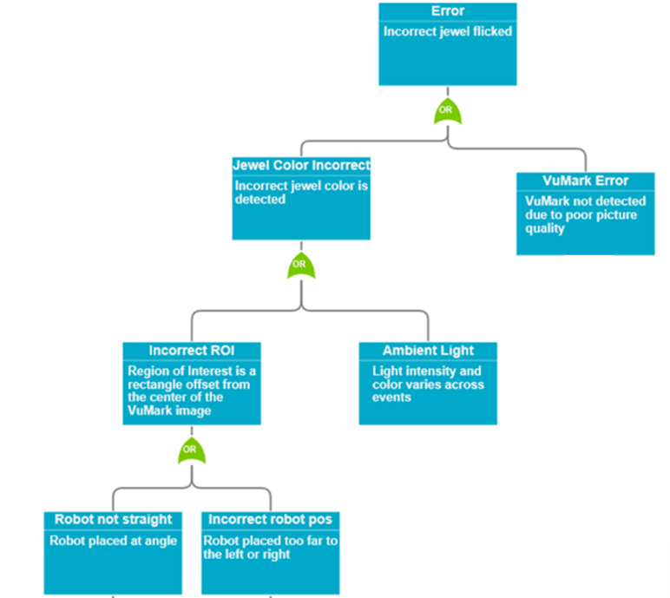
Case Study #2: Fault Tree Analysis (FTA)
SOFTWARE QUALITY CONFERENCE
PACIFIC NW
FTA: Setup and ambient light intensity affect how color is identified
PNSQC ™

Slide 22
Case Study #2: Ambient Light Experiments
SOFTWARE QUALITY CONFERENCE
PACIFIC NW
Ambient Light Experiment Setup
Tested the accuracy of color detection by amplifying and changing lighting
Standard conditions represents tournament lighting
A bright LED light and colored films changed the conditions
Results
The algorithm correctly predicted the color each time
 | Luminosity (lx) | Description | Correct Jewel
1 | 180 | Only flash | Yes
2 | 501 | Standard conditions | Yes
3 | 2400 | Light focused on VuMark | Yes
4 | 1100 | Flash and focused green light | Yes
5 | 320 | Flash and focused red light | Yes
6 | 95 | Flash and focused blue light | Yes
7 | 1400 | Standard and focused green light | Yes
8 | 450 | Standard and focused red light | Yes
9 | 190 | Standard and focused blue light | Yes
10 | 72-160 | Pulsing light | Yes
PNSQC ™

Slide 23
Conclusions
SOFTWARE QUALITY CONFERENCE
PACIFIC NW
Shared FTC engineering experience to attain software reliability in Android robotic with software-hardware integrated solutions
Established fault tree and software FMEA methodologies for prompt robot reliability improvements in the physical world
Validated the shortcut software reliability model to effectively predict defect density and help to design/build Android robots in FTC
PNSQC ™

Slide 24
Thank You!
SOFTWARE QUALITY CONFERENCE
PACIFIC NW
PNSQC committees
Reviewers: Keith Stobie and Kingsum Chow
For Inspiration and Recognition of Science and Technology (FIRST) Program
Oregon Robotics Tournament & Outreach Program (ORTOP)
FTC team coaches and mentors
Our team robot Tippy and all of our FTC teammates
PNSQC ™

Slide 25
Closing Reference
SOFTWARE QUALITY CONFERENCE
PACIFIC NW
Author email:
bytesofkitkats@gmail.com
Author social media:
https://www.facebook.com/bytesofkitkatsFTC/
PNSQC ™

